Slide 1
Interdisciplinary Team Blue
Caroline Kamm EE/ME
Patrick McBryde CpE
Olesya Nakonechnaya CpE
William Zhang CpE
WIlliam Young CS Matthew Wadle CS Frank Trapasso ME Arturo Coronado ME Cong Chen ME Lanie Greer ME Erik Datadeen ME
Autonomous Solar
Powered Beach Buggy
Notes:
PRESENTATION NEEDS TO LAST 20 MINUTES, EVERYONE'S PART NEEDS TO BE EQUAL IN TIME (AND ~maybe~ SLIDES)
It is required that each member be a presenter of technical information and present at least their portion of the technical design of the project.

Slide 2
Project Goals
To stimulate interest in both autonomous vehicle design
and solar-powered devices
To provide an advanced form of transportation to make
the beach more accessible to more people
To promote renewable energy and environmental awareness
To address the safety concerns associated with beach vehicles
Patrick
Notes:
PRESENTATION NEED TO LAST 20 MINUTES, EVERYONE'S PART NEED TO BE EQUAL IN TIME AND SLIDES
It is required that each member be a presenter of technical information and present at least their portion of the technical design of the project.

Slide 3
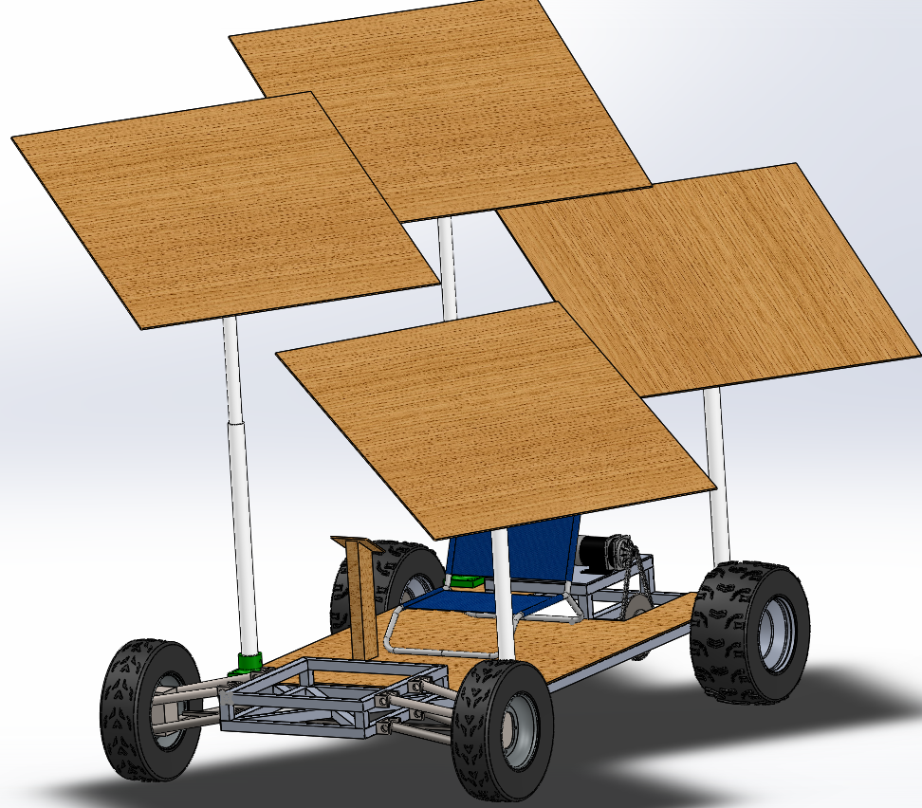
Project Objective
Design and build an autonomous beach buggy
that runs completely off solar energy
Transport one passenger
Actively prevent collisions
Navigate from one location to another without user input
Incorporate safety protocols that protect people and the environment
Notes:
PRESENTATION NEED TO LAST 20 MINUTES, EVERYONE'S PART NEED TO BE EQUAL IN TIME AND SLIDES
It is required that each member be a presenter of technical information and present at least their portion of the technical design of the project.

Slide 4
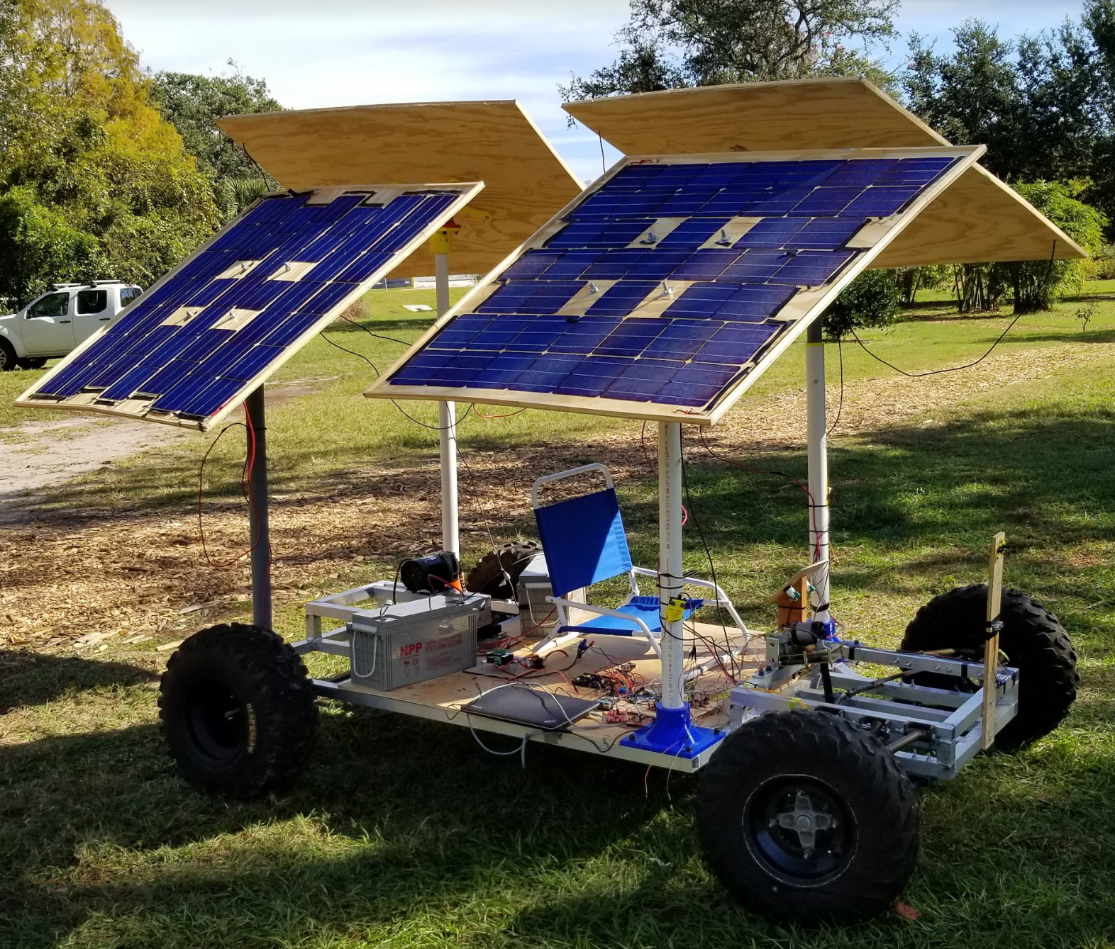
Project Specifications & Requirements
Given Specifications:
Travel 20 miles
Transport a 120 lb. passenger
Travel at no more than 3 mph
Run completely on solar energy
Complete the journey in 8 hours
Stop within 100 feet of intended destination autonomously
Final product costs less than $2,000
Notes:
PRESENTATION NEED TO LAST 20 MINUTES, EVERYONE'S PART NEED TO BE EQUAL IN TIME AND SLIDES
It is required that each member be a presenter of technical information and present at least their portion of the technical design of the project.

Slide 5
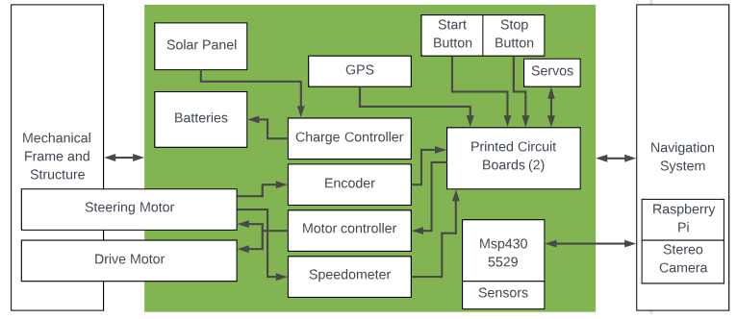
Project System Diagram
Olesya
Notes:
PRESENTATION NEED TO LAST 20 MINUTES, EVERYONE'S PART NEED TO BE EQUAL IN TIME AND SLIDES
It is required that each member be a presenter of technical information and present at least their portion of the technical design of the project.

Slide 6
Mechanical Design Approach
Notes:
PRESENTATION NEED TO LAST 20 MINUTES, EVERYONE'S PART NEED TO BE EQUAL IN TIME AND SLIDES
It is required that each member be a presenter of technical information and present at least their portion of the technical design of the project.

Slide 7
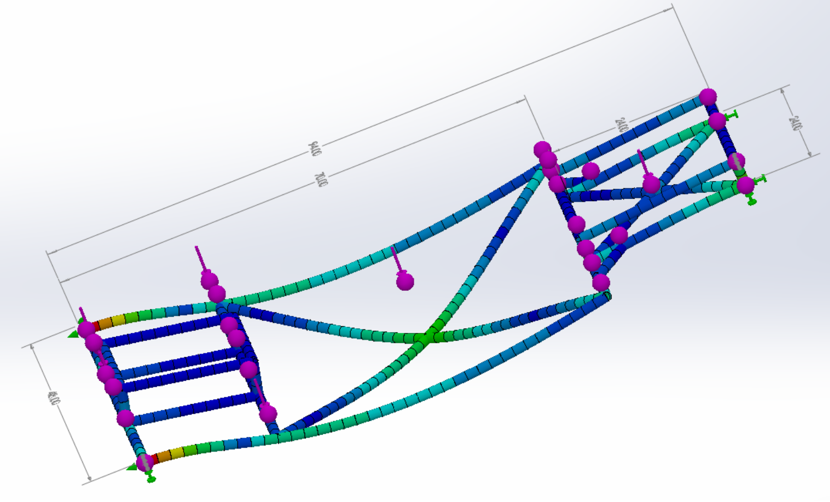
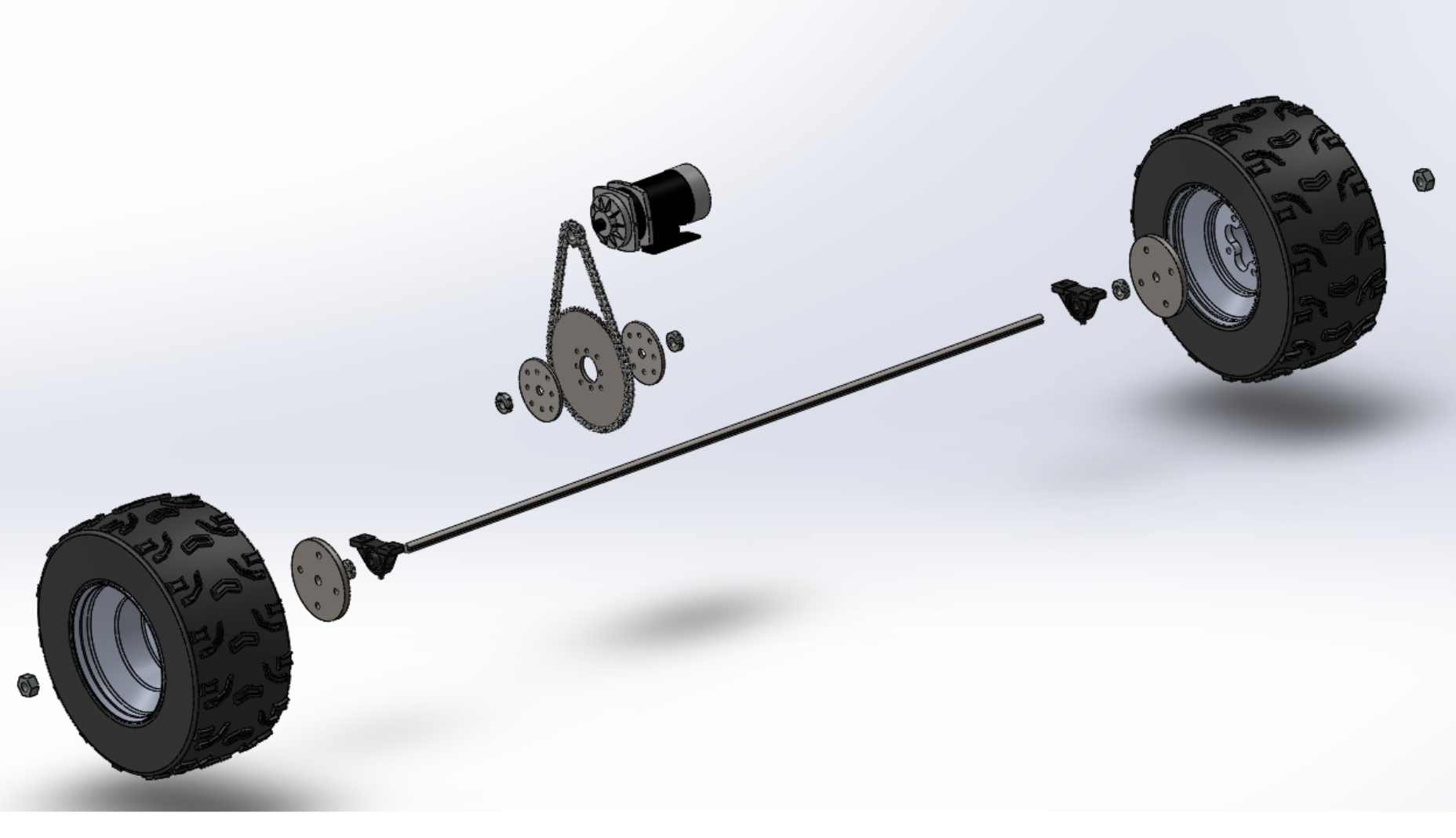
Mechanical Design Approach
Dynamic Concept Development
Motorized Power Steering
Wheels and Tires
Drivetrain
Frame design and stress analysis
Controls integration
Sensor/camera mounts
Electric steering
Notes:
PRESENTATION NEED TO LAST 20 MINUTES, EVERYONE'S PART NEED TO BE EQUAL IN TIME AND SLIDES
It is required that each member be a presenter of technical information and present at least their portion of the technical design of the project.

Slide 8
Electrical Design Approach
Notes:
PRESENTATION NEED TO LAST 20 MINUTES, EVERYONE'S PART NEED TO BE EQUAL IN TIME AND SLIDES
It is required that each member be a presenter of technical information and present at least their portion of the technical design of the project.

Slide 9
Electrical Design Approach
Load and power calculations
Motor size
Battery size
Required solar array output
Hourly solar generation calculations
Solar array size for required output
Orientation requirements → physical layout
Estimate available power for electronics
Notes:
PRESENTATION NEED TO LAST 20 MINUTES, EVERYONE'S PART NEED TO BE EQUAL IN TIME AND SLIDES
It is required that each member be a presenter of technical information and present at least their portion of the technical design of the project.

Slide 10
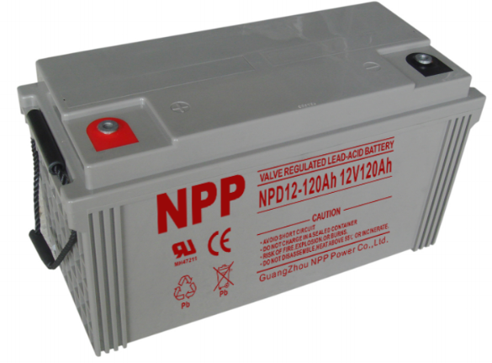
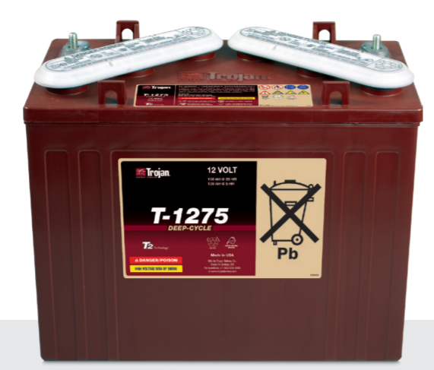
Electrical Design - Component Selection
Battery Selection
Decision Factors included:
Maximum discharge rate
Maximum charge rate
Cost
Expected capacity
Charging efficiency
Physical handling
Weight
 | NPD12-120Ah (AGM) | Trojan J150 12V 150Ah (Flooded) | Comparison
Capacity | 120 Ah @ 10 hour | 134 Ah @ 10 hour rate | Flooded has 12% more capacity but less efficient charging
Weight (x2) | 160 lbs | 170 lbs | AGM 6% lighter
Price (x2) | $445.00 | $520.00 | AGM 17% less
Notes:
PRESENTATION NEED TO LAST 20 MINUTES, EVERYONE'S PART NEED TO BE EQUAL IN TIME AND SLIDES
It is required that each member be a presenter of technical information and present at least their portion of the technical design of the project.

Slide 11
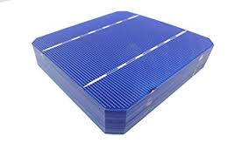
Electrical Design - Component Selection
Solar Panel Array Decisions
Max Power at STC | 235 W | 250 W | 190 W | 220 W
Max Power at NOTC | 172 W | 183 W | NA / Bifacial | 150 W
Efficiency | 14.4 % | 15 % | 15.7 % | 18.5 %
Weight | 40 lbs | 50 lbs | 50 lbs | 15 lbs
Cost | Free | Free | Free | $250
Notes:
PRESENTATION NEED TO LAST 20 MINUTES, EVERYONE'S PART NEED TO BE EQUAL IN TIME AND SLIDES
It is required that each member be a presenter of technical information and present at least their portion of the technical design of the project.

Slide 12
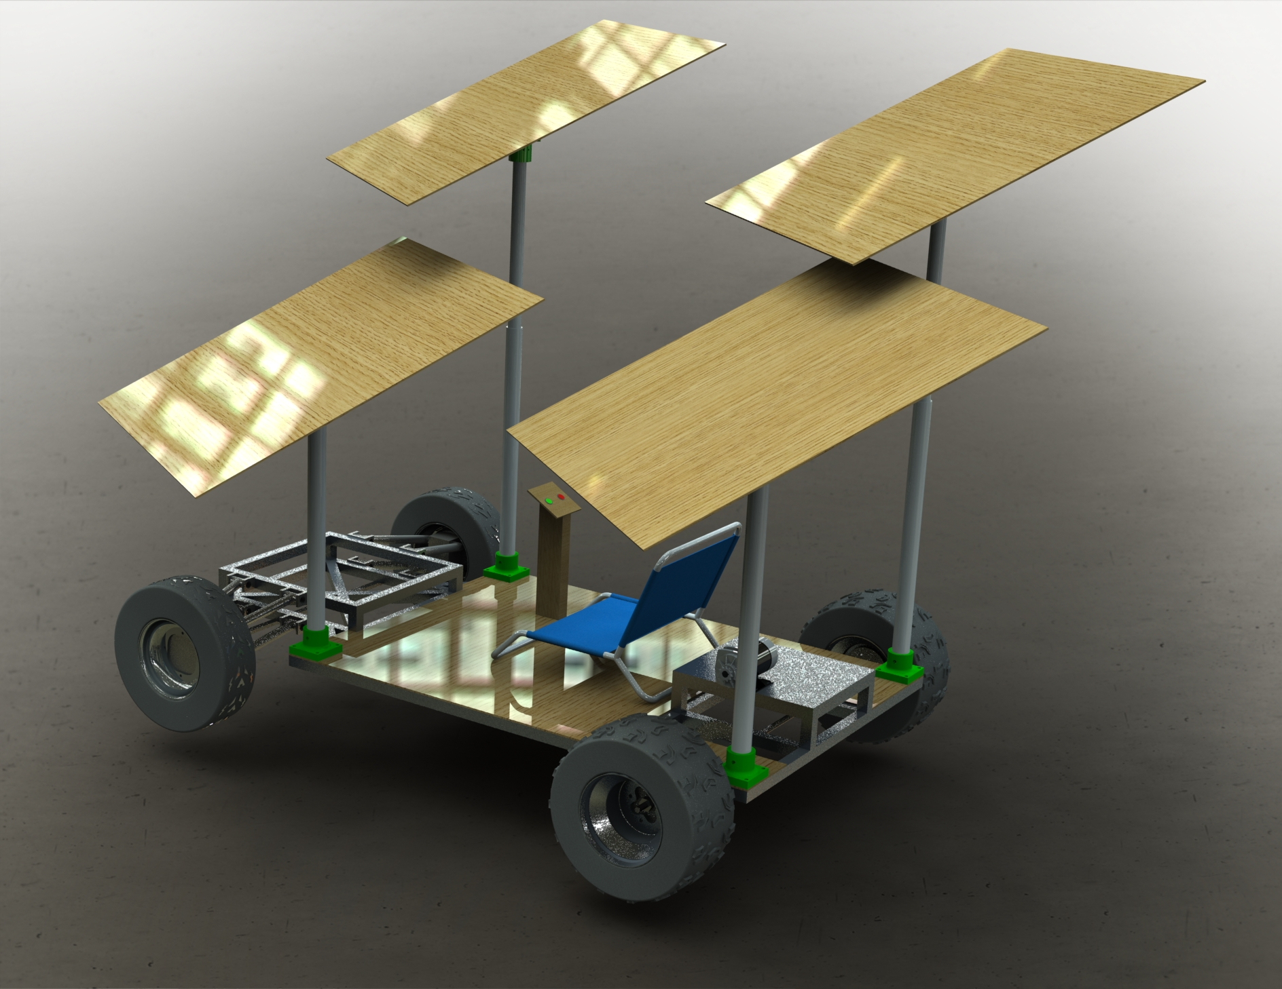
Electrical Design Approach
Solar Panel Array
180 cells x 4.74 W = 850 W STC
49V 18A System
Adjustable angles and heights for optimal UV absorption without cross-shading
Weight: ~75 lbs total
Gintech 3BB Douro Specifications:
Maximum Power | 4.74 W
Short Circuit Current | 9.31 A
Open Circuit Voltage | 641 mV
Current at 0.5V | 9.12 A
Maximum Power Current | 8.78 A
Maximum Power Voltage | 544 mV
Efficiency | 19.4 %
Fill Factor | 79.95 %
Notes:
PRESENTATION NEED TO LAST 20 MINUTES, EVERYONE'S PART NEED TO BE EQUAL IN TIME AND SLIDES
It is required that each member be a presenter of technical information and present at least their portion of the technical design of the project.

Slide 13
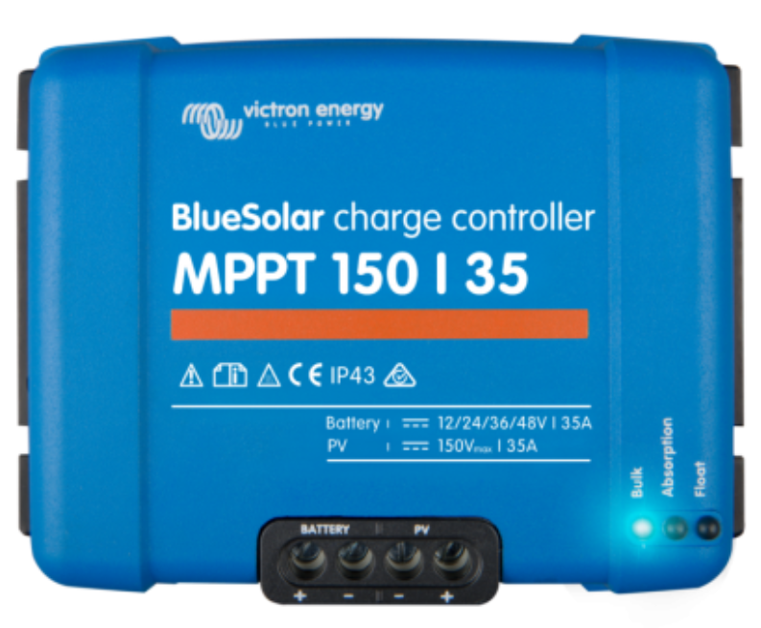
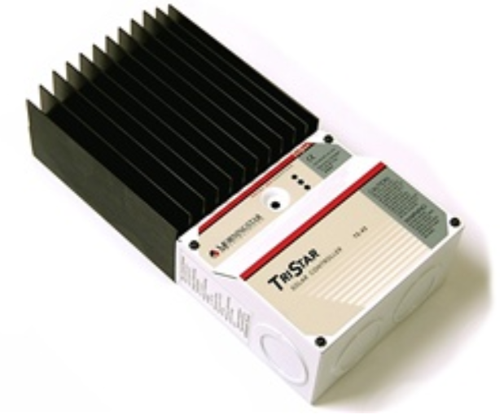
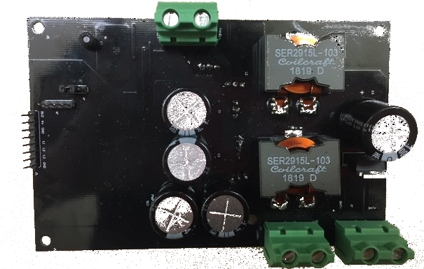
Electrical Design - Component Selection
BlueSolar MPPT Charge Controller 150/35 | MorningStar TriStar 45 Amp 12/24/48 V PWM Charge Controller | TIDA - 00120 Charge Controller TI Reference Design
MPPT algorithm: >95% efficient | PWM algorithm: 75-80% efficient | MPPT algorithm: >95% efficient
Commercial Product | Commercial Product | Reference Design Only
Real-time mobile display | No real-time user interface | No real-time user interface
$295 | $167 | $150
Expensive, no design experience | Too inefficient per calculations | Most cost-effective, most design experience

Slide 14
Electrical Design Approach
Hourly Power Calculations
= 24.88%
(end of competition)
= 110.22% = +300 W
(compared to stationary array)

Slide 15
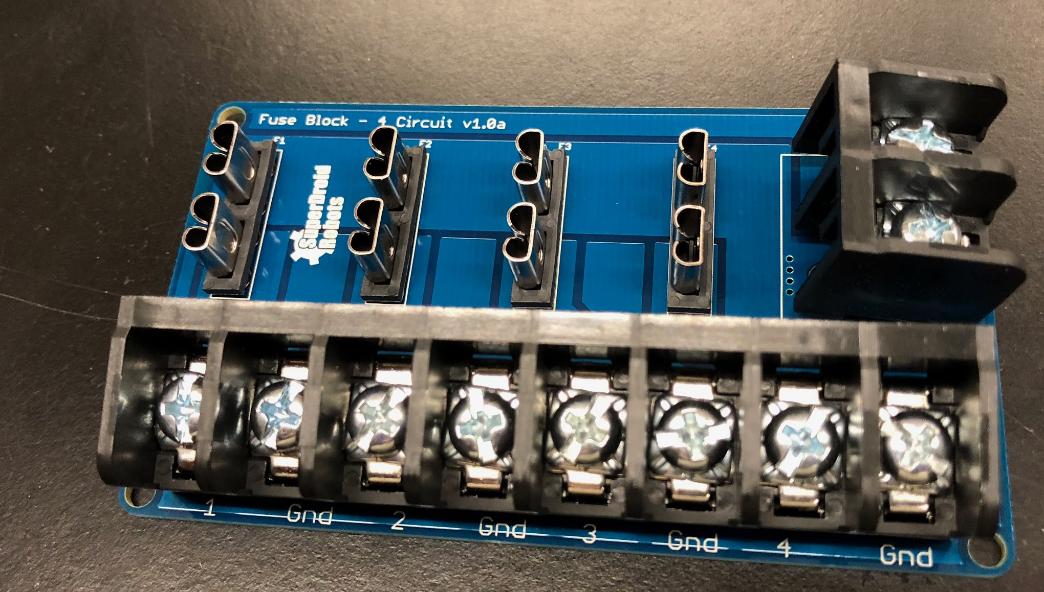
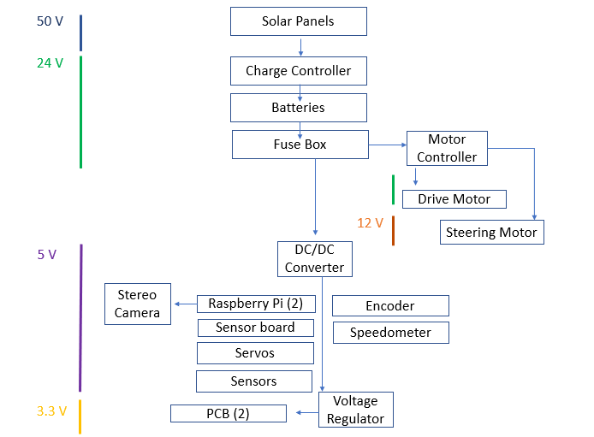
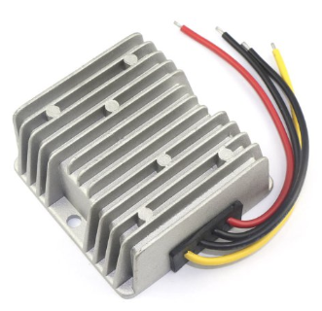
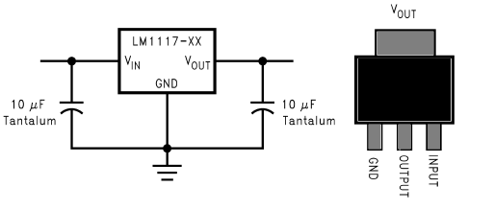
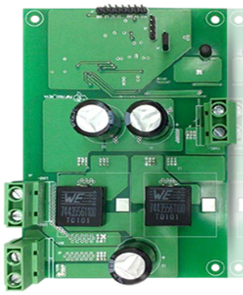
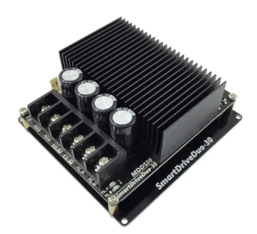
Electrical Design Approach
Full System Power Distribution
Protection devices
Fuse block
DC/DC converter
Voltage regulator
Controllers
Charge controller
Motor controller

Slide 16
Computer Science Design Approach
Notes:
PRESENTATION NEED TO LAST 20 MINUTES, EVERYONE'S PART NEED TO BE EQUAL IN TIME AND SLIDES
It is required that each member be a presenter of technical information and present at least their portion of the technical design of the project.

Slide 17
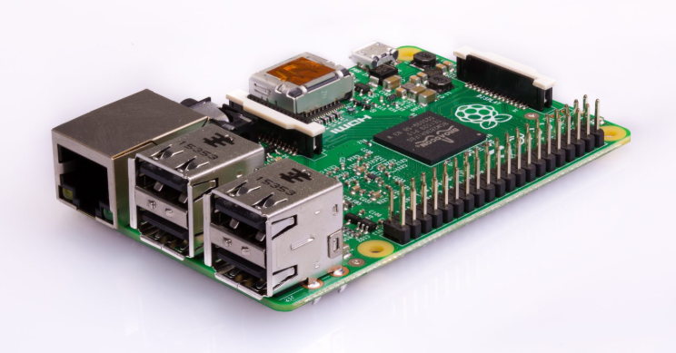
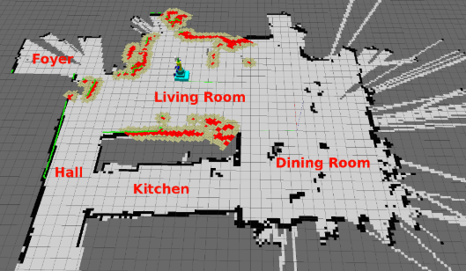
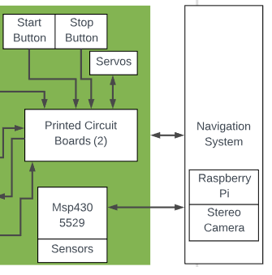
Computer Science Design Approach
Using Raspberry Pi
Navigation using Simultaneous Localization and Mapping (SLAM technique).
Measuring distances by creating a disparity image to detect obstacles.
Looking into creating a neural network to identify detected objects.
Notes:
PRESENTATION NEED TO LAST 20 MINUTES, EVERYONE'S PART NEED TO BE EQUAL IN TIME AND SLIDES
It is required that each member be a presenter of technical information and present at least their portion of the technical design of the project.

Slide 18
Computer Engineering Design Approach
Notes:
PRESENTATION NEED TO LAST 20 MINUTES, EVERYONE'S PART NEED TO BE EQUAL IN TIME AND SLIDES
It is required that each member be a presenter of technical information and present at least their portion of the technical design of the project.

Slide 19
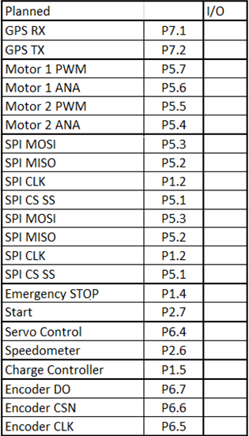
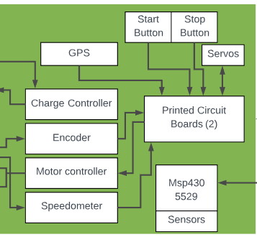
CpE Design Approach
SPI Interface
PWM
ADC
22 Pins Minimum
3.3v I/O
5V I/O
Notes:
PRESENTATION NEED TO LAST 20 MINUTES, EVERYONE'S PART NEED TO BE EQUAL IN TIME AND SLIDES
It is required that each member be a presenter of technical information and present at least their portion of the technical design of the project.

Slide 20
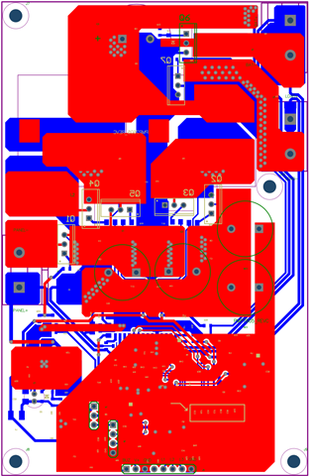
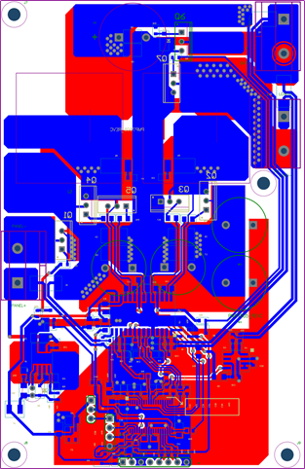
Charge Controller Design
TIDA-00120 Reference Design
(Texas Instruments)
MPPT - Maximum Efficiency
Supports systems up to 48V & 40A
Designed system is 49V & 18A
Highly reconfigurable
Efficiency = >97%
Battery Protection
Programmable Software

Slide 21
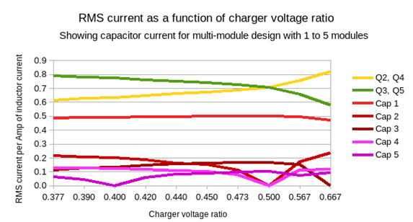
Charge Controller Design

Slide 22
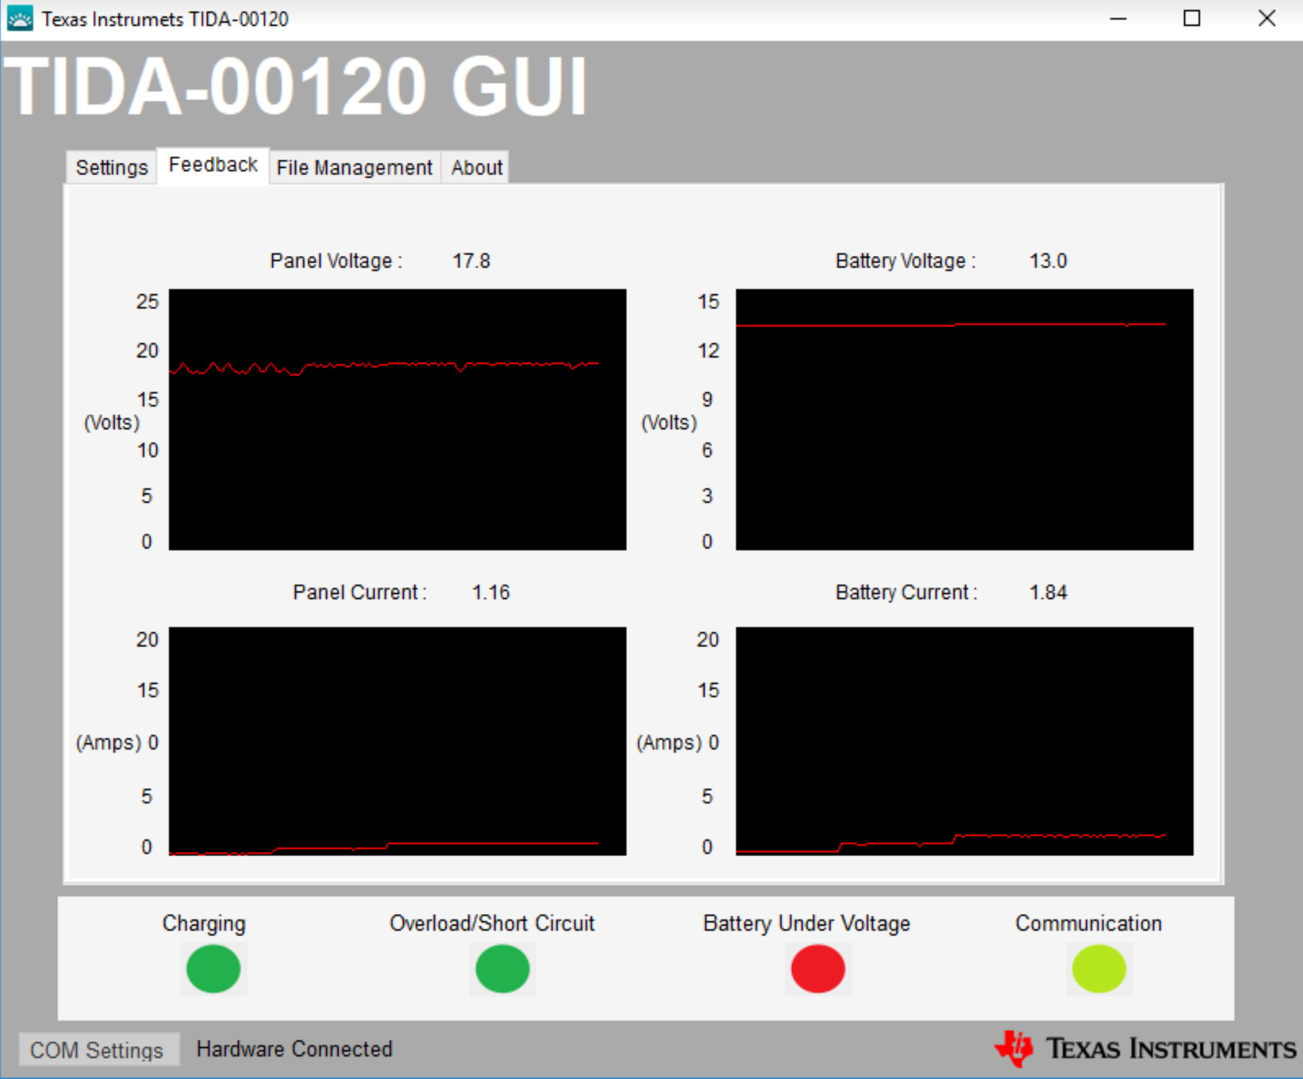
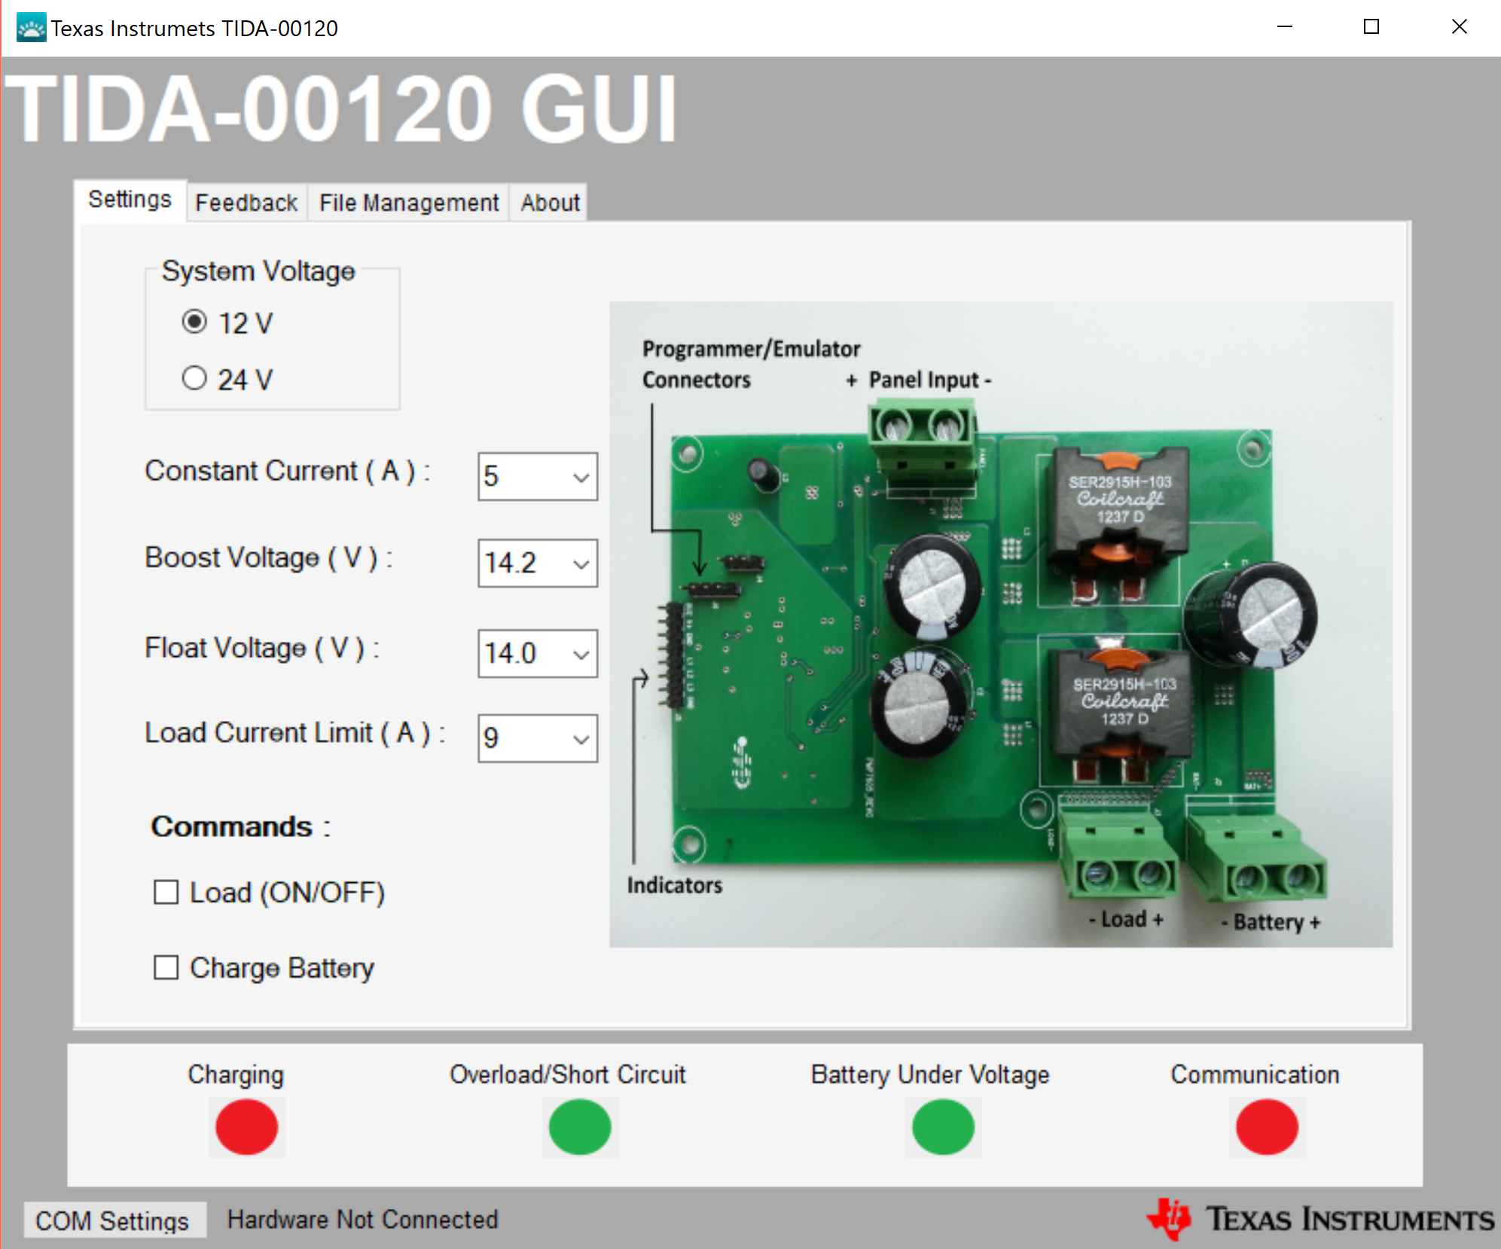
Charge Controller Programming
System Indicators
System Status
System settings
System Voltage
Battery Current Limit
Maximum Load
Real Time Feedback
Panel / Battery Voltage
Panel / Battery Current

Slide 23
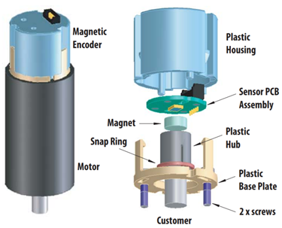
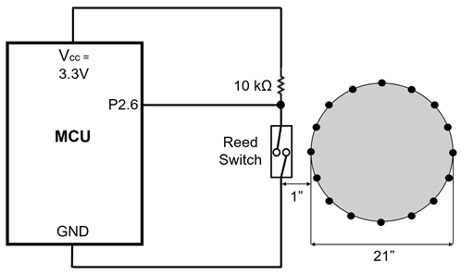
Motor Feedback
Absolute Encoder - Steering Motor Speedometer - Drive Motor
Encoder cost: $26
Speedometer cost: $12

Slide 24
MCU PCB Design
Notes:
PRESENTATION NEED TO LAST 20 MINUTES, EVERYONE'S PART NEED TO BE EQUAL IN TIME AND SLIDES
It is required that each member be a presenter of technical information and present at least their portion of the technical design of the project.

Slide 25
MCU PCB Design
Processor
 | Program Size | Test Board | Familiarity | Design Opportunity | Available Pins | SPI | PWM | ADC
MSP430 F5529 | ++ | + | ++ | ++ | 63 | 2 | 14 | 17
MSP430 FR4133 | - | - | ++ | ++ | 24 | 2 | 6 | 9
MSP430 G2 | -- | ++ | +++ | ++ | 16 | 2 | 6 | 5
UNO | + | + | -- | + | 24 | 2 | 6 | 12
RPI | +++++ | + | -- | -- | 36 | - | - | -
+2
-1
- 2
Notes:
PRESENTATION NEED TO LAST 20 MINUTES, EVERYONE'S PART NEED TO BE EQUAL IN TIME AND SLIDES
It is required that each member be a presenter of technical information and present at least their portion of the technical design of the project.

Slide 26
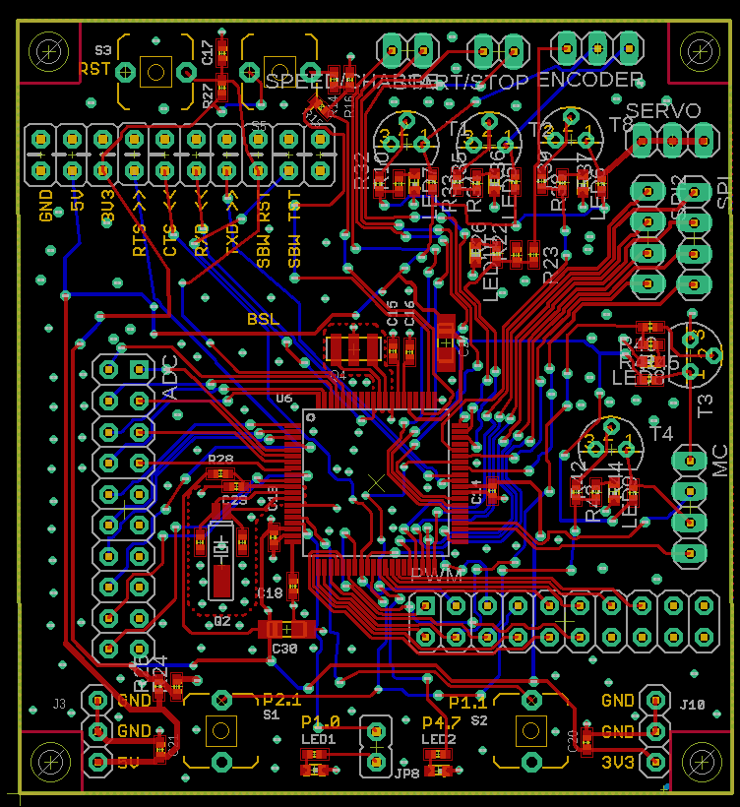
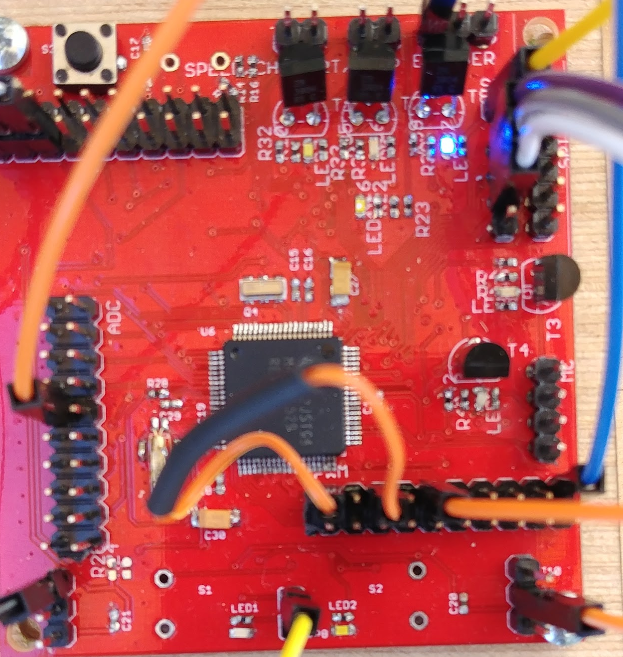
MCU PCB Design
Eagle Board Layout
Actual PCB Prototype
Cost of PCB: $35
Cost of Components:$90
TOTAL
Notes:
PRESENTATION NEED TO LAST 20 MINUTES, EVERYONE'S PART NEED TO BE EQUAL IN TIME AND SLIDES
It is required that each member be a presenter of technical information and present at least their portion of the technical design of the project.

Slide 27
PCB Design
Communication Protocol
UART
Async
Half-duplex
2 wires max
Easy to implement
I2C
Sync
Any # of slaves and masters
Half-duplex
2 wires max
SPI
Sync
Any # of slaves
But only 1 master
Full-duplex
1 additional wire per slave
 | Synchronization | Full-Duplex? | # of Slaves | # of Masters | # of Wires
SPI | ++ | Yes | Any | 1 | 3 + (1 per slave)
I2C | ++ | No | Any | Any | 2
UART | -- | No | 1 | 1 | 2
+2
-1
- 2
Notes:
PRESENTATION NEED TO LAST 20 MINUTES, EVERYONE'S PART NEED TO BE EQUAL IN TIME AND SLIDES
It is required that each member be a presenter of technical information and present at least their portion of the technical design of the project.

Slide 28
Sensors
Degree Coverage of the Navigation System
Primary Purpose: Emergency System Stop feature that will add another layer of safety by detecting objects outside the view of the camera.
Secondary Purpose:
Redundant System to the Navigation System to check distance calculations and to identify out of scope objects.
Notes:
One of the main requirements for the project is safety, so we wanted to add another layer of safety through an emergency

Slide 29
Sensors
Constraints
Ultrasonic Inexpensive, durable, meets range requirement, accurate for cost
Infrared Inexpensive, work well outdoors, meets range requirement, accurate for cost
Radio
Research was based on the constraints
Detection range of 5 feet and stopping range of 1.5 feet based on the buggy’s 3 mph speed limit
Need to cover the front and sides of buggy, about 5+ sensors
Budget constraint of 30 dollars, | 5 - 7 dollars a sensor unit.
 | Cost | Range | Outdoor | Accuracy | Total
 | $4-7 | 30-300 cm | 75 -90 ° | per cost
Ultrasonic | ++ | ++ | - | + | 8
Infrared | ++ | + | - | + | 6
Radio | - | - | + | + | 0
Lidar | -- | + | + | - | -1
+2
-1
- 2

Slide 30
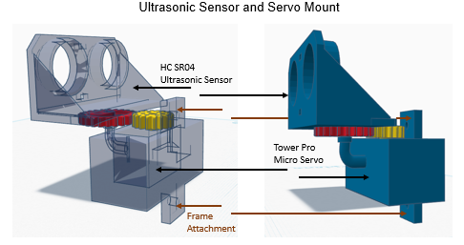
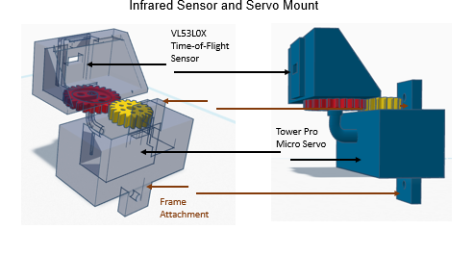
Sensor Mounts
Coverage around the Buggy
Added servos to the design to rotate the sensors
Created mounts that will allow the sensors and servos to be mounted anywhere on the buggy

Slide 31
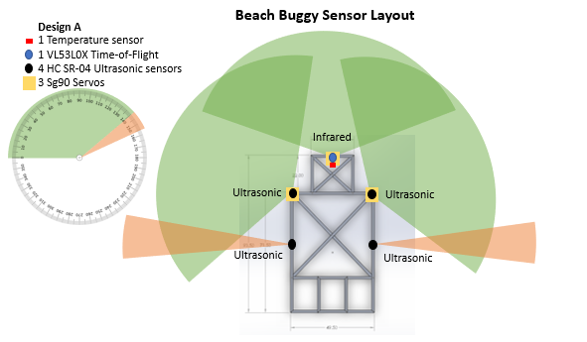
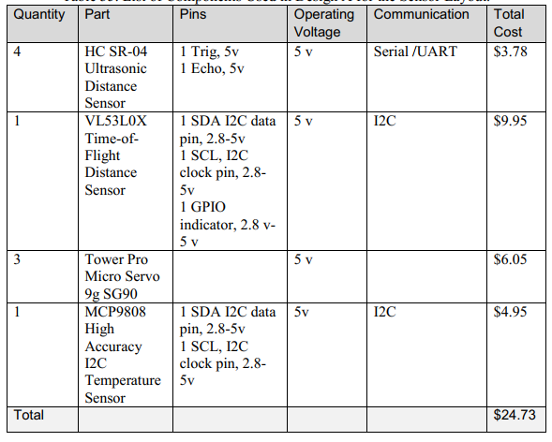
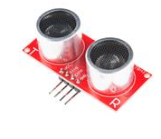
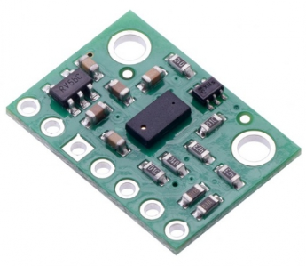
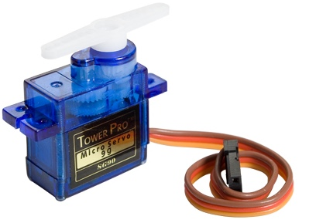
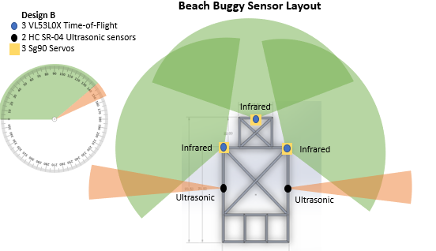
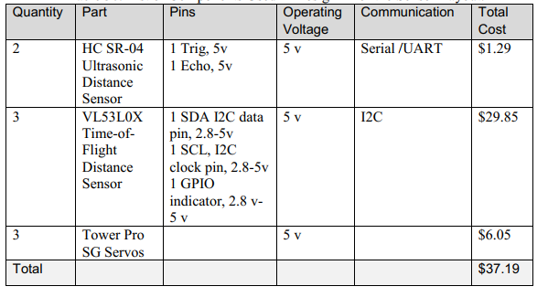
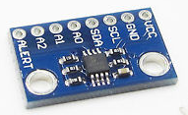
Sensors

Slide 32
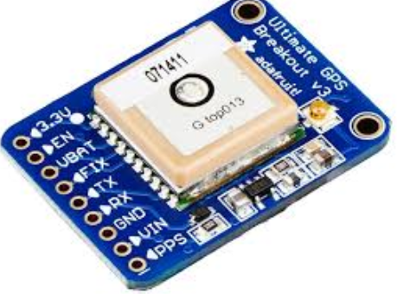
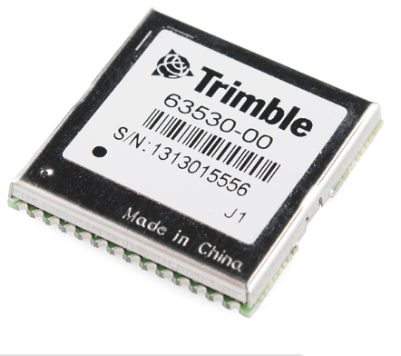
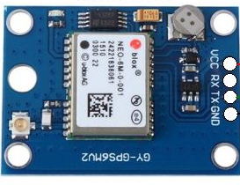
GPS
Adafruit Ultimate GPS Breakout
Copernicus II GPS Module
NEO-6M GPS Receiver Module
-> Serial communication support -> Cost effective (< $20) -> Well documented -> Compatible with MSP430

Slide 33
Project Implementation

Slide 34
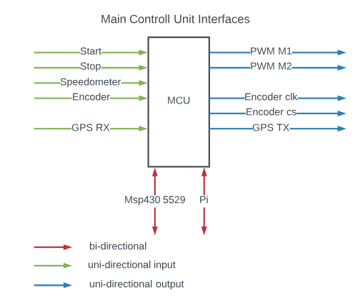
PCB Software
Software on the Main Control Unit
-> Communicate with two other systems
->Interrupts for certain pins
->Data polling for certain pins
->Create PWM signals
->Support SPI Interfaces
Olesya

Slide 35
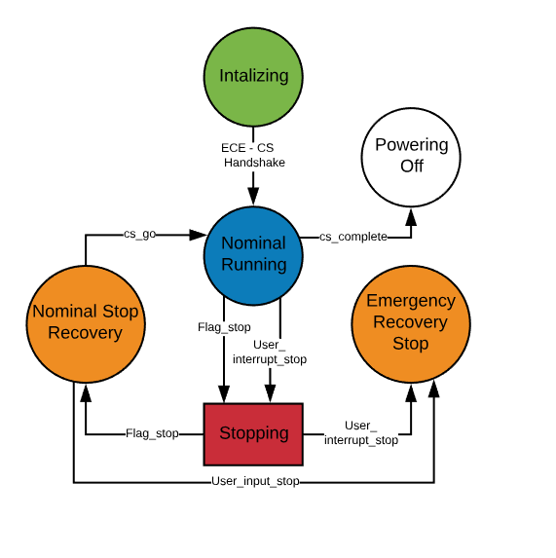
MCU State Machine
High Level Overview
-> Initializing: Checks all systems, handshake with CS system.
->Nominal Running: Reads and process all inputs, send data to navigation system, decode and execute navigation system data .
->Stopping: Stops motors.
->Recovering_Stop: Waits for Navigation system flag to continue.
->Recovering_Emergency: Waits for user input to continue.
Olesya
Notes:
Most significant states to implement

Slide 36
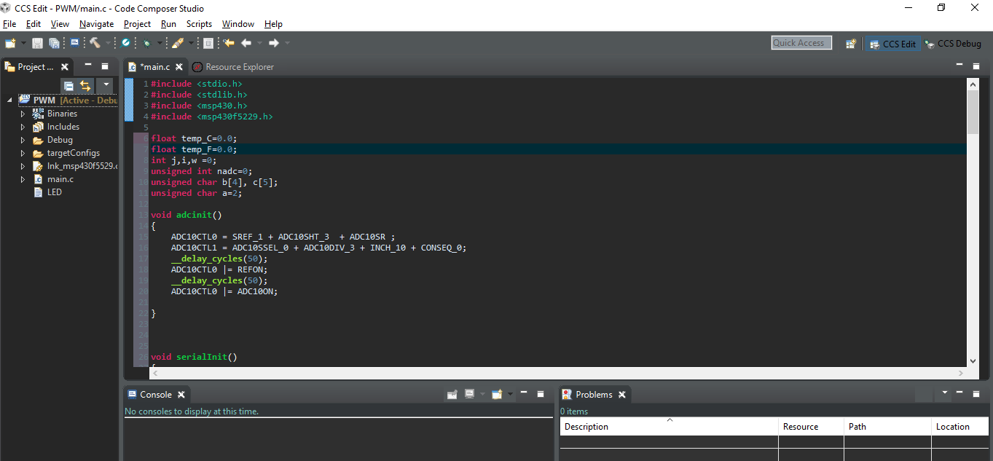
Software Tools
TI RTOS and Code Composer Studio v8
More Hardware Control
TI-RTOS has support for multitasking and memory management. TI- RTOS also manages power and timers/interrupts Resource Helper Texas Instruments has a RTOS module that is supported out of the box.

Slide 37
Software Overview
TI RTOS Tasks
GPS - Receives gps NMEA strings from module and parses the information for long, lat, and velocity.
PWM - Vary to duty cycle and control the speed of each motor.
Encoder - Tracks the movement of the steering motor to give us feedback for PID.
SPI - Send communication packet to the Navigation system.
Olesya, Patrick

Slide 38
Software Overview
Interrupts
Speedometer - Times tire rotation to be able to determine speed
Start/Stop Buttons - Emergency stop button that disables both motors and Start button to enable them again
Olesya, Patrick

Slide 39
Project Difficulties

Slide 40
SPI and PWM Difficulties
Patrick
Problem | Solution
Hard to implement RPi Slave | RPi Master and MSP Slave
PWM Synchronization | Implement TI-RTOS

Slide 41
Software Limitations
Concerned with initial PCB design using the FR43133 instead of the current design, space was concern.
To fix this problem and to simplify PCB design and code, we decided to offload the sensors to another microprocessor.
After switching the design we had enough space, but we wanted to keep this to streamline the code on the processor.
Olesya

Slide 42
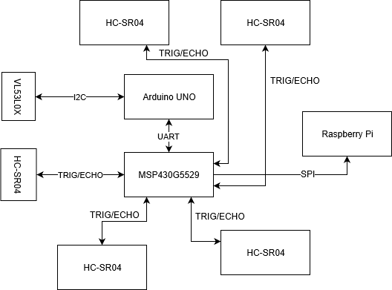
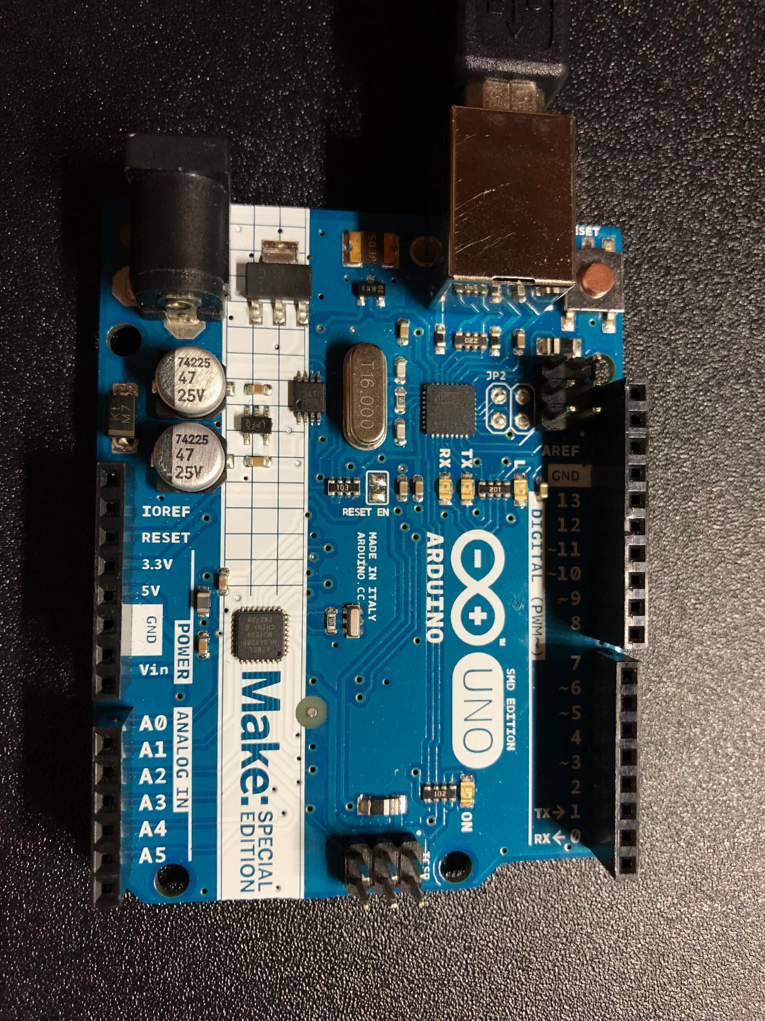
RIGHT
FRONT
REAR
GPIO
GPIO
LEFT

Slide 43
Project Budget
Total Budget: $2,244.10
Final Buggy Value: $2,072.75
Development Cost: $171.35
Caroline/Patrick

Slide 44
Administrative Roles
 | Power System |  | PCB Design and Manufacturing |  |  | Sensors
 | Solar Power | Batteries, Protection, Distribution | Main Control Unit | Charge Controller | Software Design and Implementation | Mounts | Software
Caroline | P | P |  | P | S
Olesya |  | S | S |  | P | P
Partick | S |  | P | S | S
William |  | S |  |  |  |  | P
P = Primary Responsibility S = Secondary Responsibility

Slide 45
Demo
Charge Controller
Printed Circuit Boards PWM/GPS Encoder/Speedometer/SPI
Sensor System MSP430F5529: HC-SR04s Arduino UNO: VL53L0X
Autonomous Solar
Powered Beach Buggy
Notes:
PRESENTATION NEEDS TO LAST 20 MINUTES, EVERYONE'S PART NEEDS TO BE EQUAL IN TIME (AND ~maybe~ SLIDES)
It is required that each member be a presenter of technical information and present at least their portion of the technical design of the project.

Slide 46
Questions?
Autonomous Solar
Powered Beach Buggy
Notes:
PRESENTATION NEEDS TO LAST 20 MINUTES, EVERYONE'S PART NEEDS TO BE EQUAL IN TIME (AND ~maybe~ SLIDES)
It is required that each member be a presenter of technical information and present at least their portion of the technical design of the project.

